Slide 1

Smart Recipe Tracker Using Natural Language Processing
Team Members:
A. jaya surya (2403a52259)
K.Akhil (2403a52241)
V.Harsha vardhan ( 2403a52265)
Institution: SR University | Guide: Dr. V.Venkataramana

Slide 2

Problem Statement
Current Challenges
Traditional recipe systems rely on keyword-based search and cannot understand natural language queries, lacking personalization based on user preferences.
Unstructured Data
No Personalization
Poor Query Understanding
Difficulty handling recipe data in natural language format
Cannot adapt to dietary needs or available ingredients
Users struggle with time constraints and ingredient limitations
Our Goal: Build an intelligent NLP-powered system that understands natural language queries and provides personalized recipe recommendations based on user context.

Slide 3
Stakeholders
This intelligent recipe system serves diverse user groups with varying needs and applications.
End Users
Health-Conscious Users
Food Industry
Home cooks, students, and working professionals seeking convenient meal planning solutions
Diet planners and fitness enthusiasts managing nutritional requirements
Restaurants and recipe platforms looking for enhanced recommendation engines
Researchers & Developers
Cloud Providers
Hosting and scalability support for deployment infrastructure
AI and NLP practitioners advancing natural language understanding in culinary applications

Slide 4
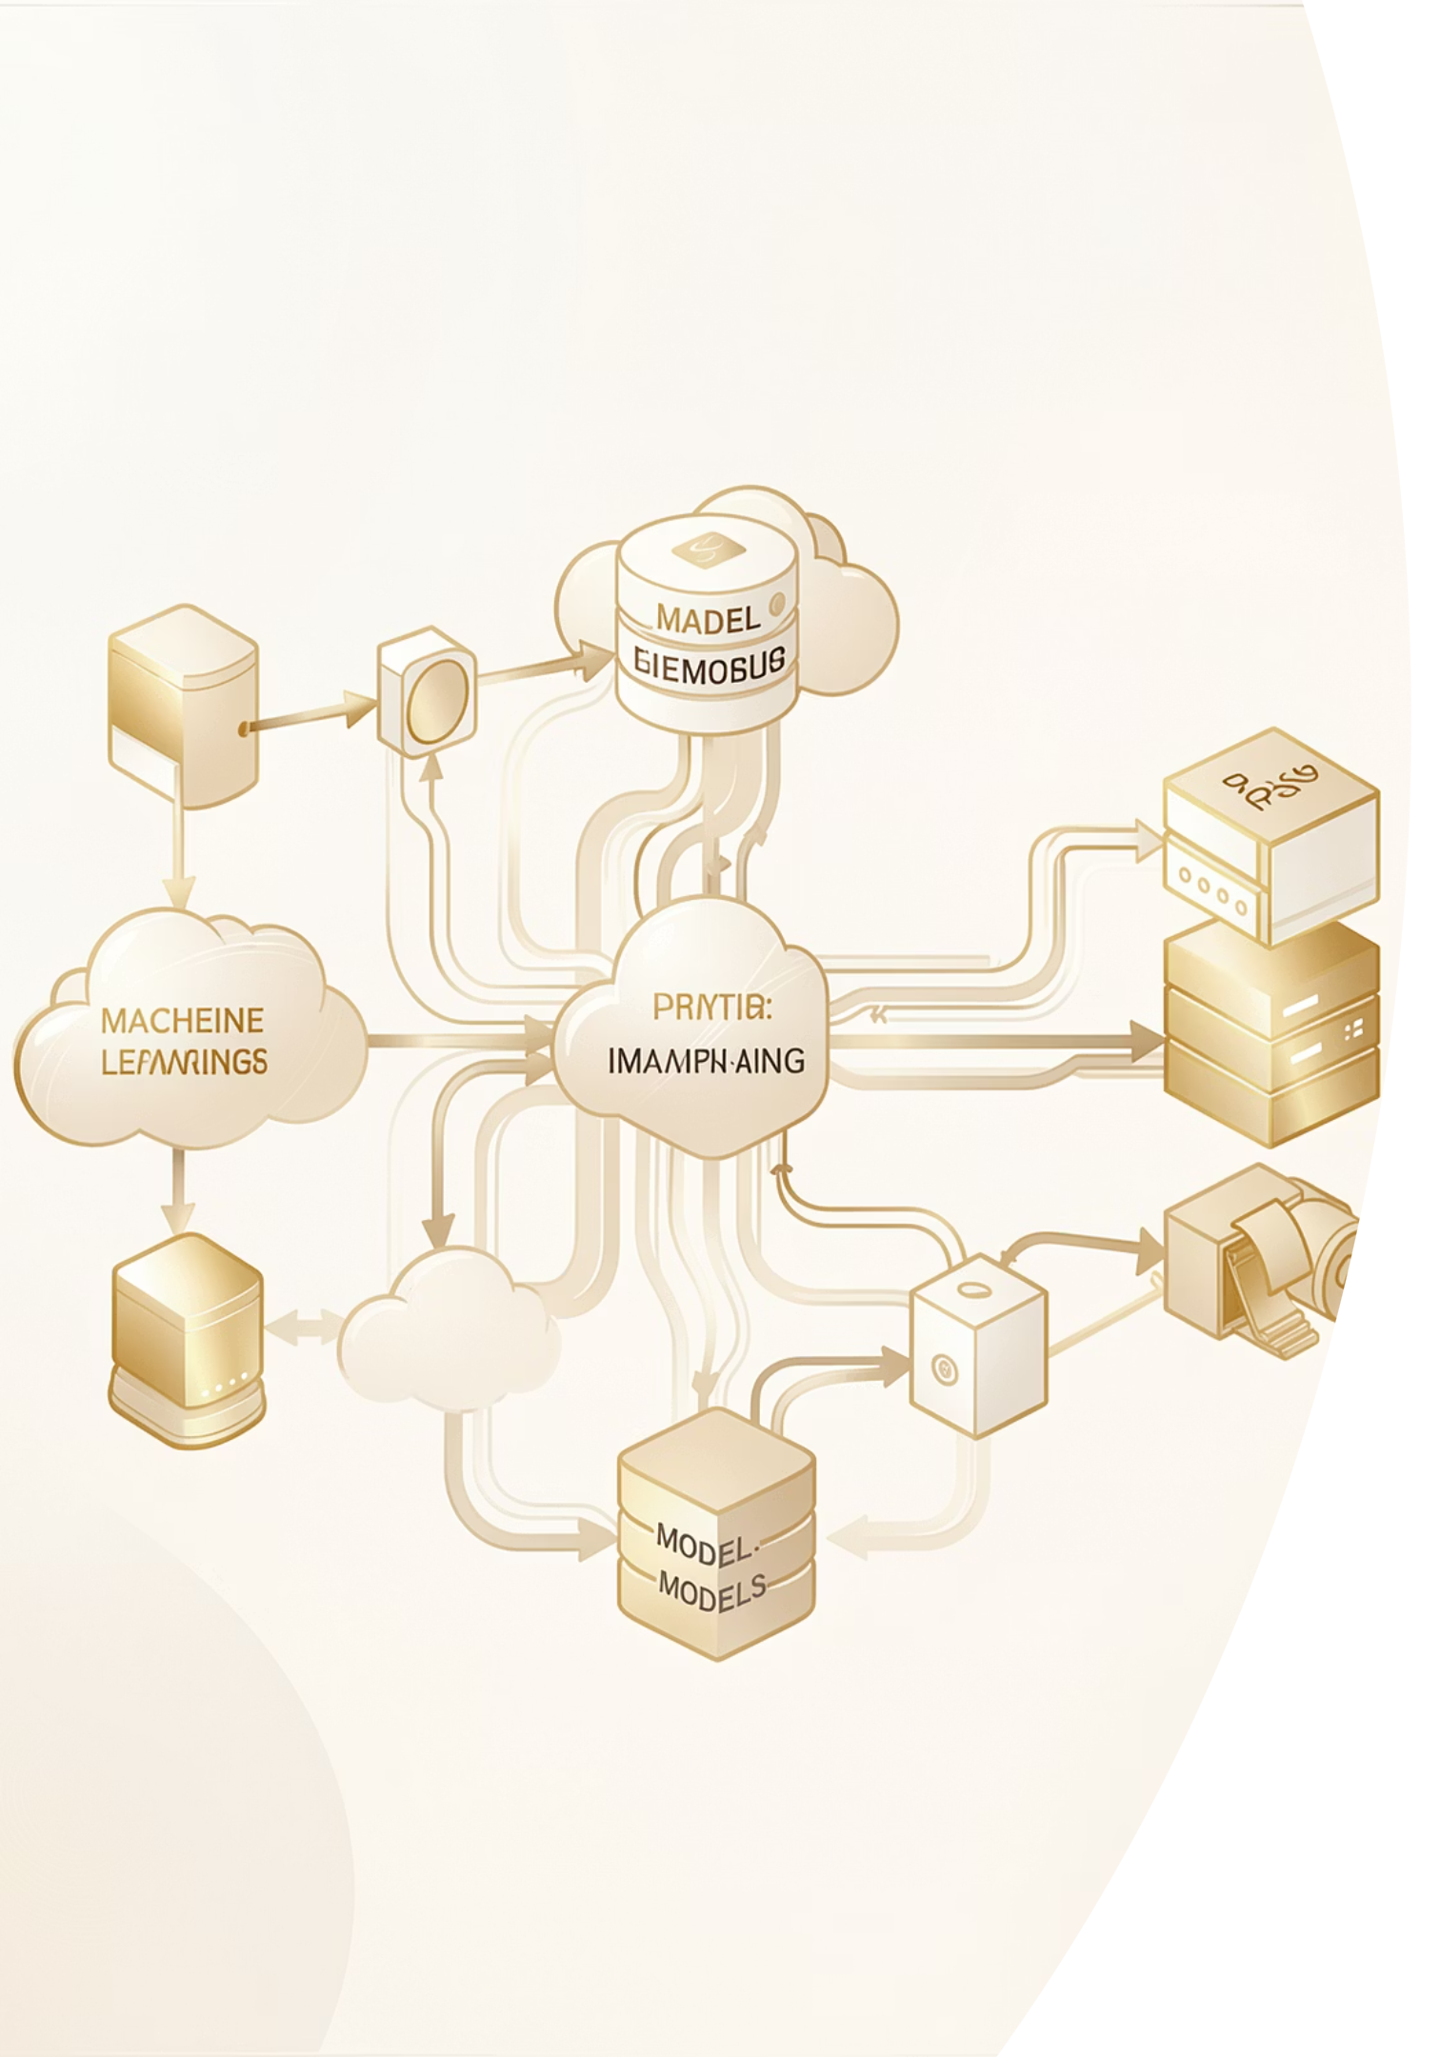
Dataset and Model Discussion
Dataset Source
Models & Techniques
Collected from Kaggle and online recipe platforms containing comprehensive recipe information:
NLP preprocessing (tokenization, stopword removal)
TF-IDF for feature extraction
Word embeddings (Word2Vec/GloVe)
Named Entity Recognition (NER)
Cosine similarity for recommendations
Recipe names and titles
Complete ingredient lists
Step-by-step instructions
Preparation and cooking times
Nutritional details and values
Machine Learning Classifiers
Logistic Regression and Support Vector Machine (SVM) for classification tasks

Slide 5

Results
Our NLP-powered system achieved strong performance metrics, significantly outperforming traditional keyword-based approaches.
85-90%
High
Efficient
Accuracy Rate
Precision & Recall
NER Extraction
In recipe recommendations
Score consistency
Ingredient identification
User Experience
Users found the system significantly more intuitive and user-friendly compared to traditional recipe search platforms.
The NLP engine demonstrated superior query understanding, handling complex natural language requests effectively.

Slide 6




Cloud-Hosted Application
Deployment Platforms
AWS, Google Cloud, or Azure for scalable hosting
Web Interface
Real-time recipe search with responsive design
Personalization
AI-powered recommendations based on preferences
Key Benefits
Future Scope
Scalability: Handle growing user base
Accessibility: Remote access from anywhere
Performance: Fast processing and response
Mobile app development with iOS and Android versions, plus voice assistant integration for hands-free cooking experience.

Slide 7




Conclusions & Future Enhancements
Enhanced Search
Smart Recommendations
NLP significantly improves recipe search and management
Provides personalized and intelligent recipe suggestions
Natural Understanding
Better UX
Handles natural language queries effectively
Enhances user experience versus traditional systems
Future Enhancements
01
02
03
Voice-Based Cooking Assistant
Smart Kitchen Integration
Transformer Models
Hands-free interaction while cooking
Connect with IoT devices and appliances
Advanced deep learning architectures like BERT

Slide 8

References
Textbooks & Resources
Datasets & Models
Jurafsky & Martin – Speech and Language Processing
Natural Language Processing with Python (NLTK)
Stanford NLP Resources
Kaggle Recipe Dataset
Word2Vec – Mikolov et al.
Documentation
Scikit-learn Documentation
TensorFlow NLP Tutorials

